Slide 1
Parallel Computing
Matrix Multiplication
By
Daniel Weitman

Slide 2
Background
Parallel computing is a method for optimizing the processing power of a system
Parallel systems utilize multiple processors/cores within the same hardware or share processors/cores over a network
Parallel algorithms require overhead to initiate resulting in a worse performance for small inputs

Slide 3
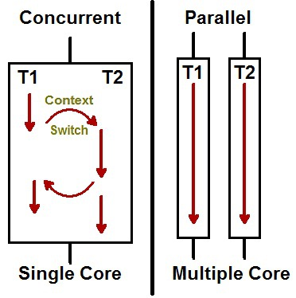
Background
Concurrency vs Parallelism
Concurrency is multiple processes are loaded into memory and compute based on scheduler
Parallelism is multiple processes/threads computing simultaneously
Threads
Threads split a large program into several discrete subtasks
Each processor can independently work on a subtask
Run separately but share address space
Thread Example
Consider GPA.cpp
Thread1 (T1) - Finds the average GPA
Thread2 (T2) - Sorts the GPAs
Both threads share set<double> gpa;

Slide 4
Flynn’s Taxonomy
SISD - Single instruction, Single data
Serial computations, oldest type of computer system
One piece of data follows a single instruction stream
SIMD - Single instruction, Multiple data
Parallel computations, majority of modern PCs
Several chunks of data follow a single instruction stream
MISD - Multiple instruction, Single data
Parallel computations, rare system as applications are highly limited
One piece of data is feed into several different instruction streams
MIMD - Multiple instruction, Multiple data
Parallel computations, modern day supercomputers
Several data components are fed into multiple disjoint instruction streams

Slide 5
OpenMP - Overview
OpenMP stands for Open Multi-Processing
An API that simplifies the process of parallelizing algorithms
Compatible with C/C++/Fortran
Industry standard
OpenMP is comprised of
Compiler directives
Library functions
Environment variables

Slide 6
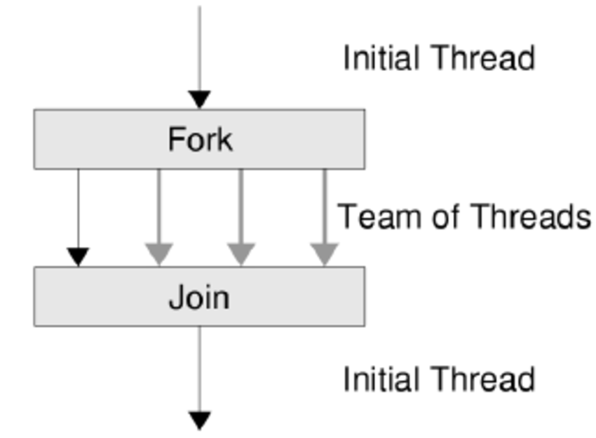
OpenMP - Compiler Directives
#include <omp.h>
#pragma omp parallel{...} - Compiler directive marking the start of a parallel section
#pragma omp for - Tells the compiler the following for loop is going to be parallelized
int array[100];
#pragma omp parallel for
for(i = 0; i < 100; i++){
array[i] = calculation(i);
}
T1: [00-24]
T2: [25-49]
T3: [50-74]
T4: [75-99]
T1 T2 T3 T4

Slide 7
OpenMP - Library Functions & Environment Variables
omp_set_num_threads(n);
Allocate up to n available threads to work on the current process
omp_get_wtime();
Returns the time elapsed from an arbitrary point earlier in time
omp_get_num_threads();
Returns an integer of the threads currently allocated
omp_get_thread_ num();
Returns a number for identifying the thread

Slide 8
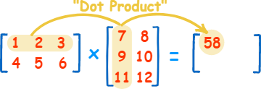
Matrix Multiplication
A: 2x3 B: 3x2 C: 2x2 3=3
C: 58 64
139 154

Slide 9
Matrix Multiplication
Assuming all matrices are nxn in dimensions
Uses nested for loops
Time Complexity: O(n³)
Certain more complex algorithms can improve the time complexity
Optimal algorithm is still unknown
Real-world applications
Computer Graphics
Linear Algebra
Physics
Eigenvectors (Google page ranks)

Slide 10
Matrix Multiplication
#pragma omp parallel shared(product)
{
#pragma omp for schedule (static, chunk)
for(int i = 0; i < product.rows; i++){
for(int j = 0; j < product.columns; j++){
product.setElement(0, i, j);
for(int k = 0; k < columns; k++){
product.setElement
((product.mat[i][j]+=(mat[i][k]*obj.mat[k][j])), i, j);
}
}
}//End of matrix multiplication
}//End of parallel section

Slide 11
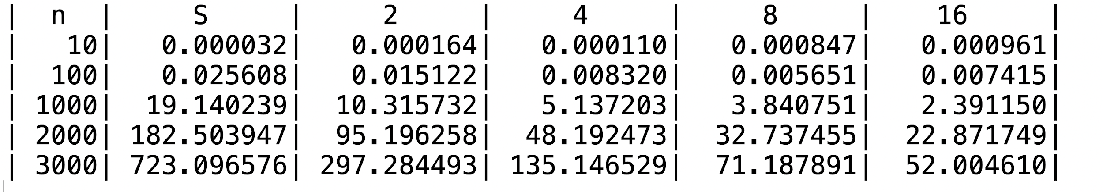
Time analysis
n: Number of rows/columns
S: Time serially computed
#: Time computed using # threads

